Slide 1
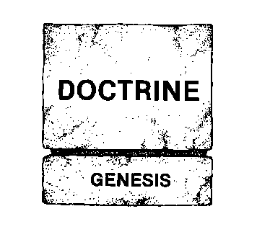
Creation / Evolution
Does It Matter What We Believe?
Mike Riddle
Institute for Creation Research
www.icr.org

Slide 2
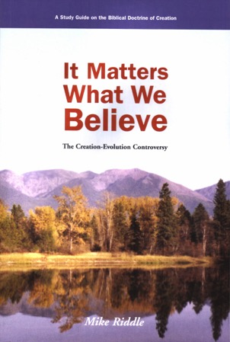
Topics
Two models of history
7 Biblical truths why it matters
Science and why it matters
Conclusion: Why it matters what we believe

Slide 3
Creation Model
God created the universe and everything in it in 6 days
Sin was the cause of death
God destroyed the world by a worldwide flood
Man was created in the image of God
God created ALL things

Slide 4
Evolution Model
About 15 billion years ago the universe exploded into existence
About 4.6 billion years ago the earth evolved
About 3.5 billion years ago life evolved
Humans evolved from ape-like creatures
Time, chance, and natural processes

Slide 5
Creation and the Bible
Three Rules of Interpretation
1. Context - context - context
2. Let Scripture interpret Scripture
3. Don't let our experiences interpret the Bible

Slide 6
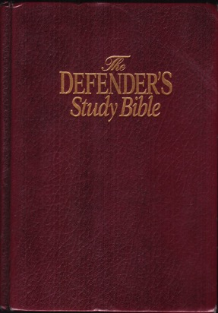
Part 1
The Bible and
Why It Matters

Slide 7
The Process for Creation
1
Evolution model
The Bible
“And God said”
Psalm 33:6,9 “By the Word of the Lord…”
Hebrews 11:3
Through faith we understand that the worlds were framed by the word of God, so that things which are seen were not made of things which do appear.
What the Bible does NOT say

Slide 8
The Order of Events
2
The earth and stars
Birds and reptiles
The earth and water

Slide 9
The Cause of Physical Death
3
Evolution: natural process
Bible: sin (Rom 5:12, 1Cor 15:21)
Curse (Genesis 3:17)
Put out of the Garden to keep from eating from the tree of life (Genesis 3:22-24)
“Very Good” (Genesis 1:31)
Animal death
Plant death

Slide 10
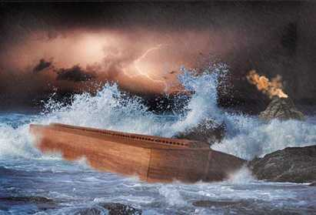
The Genesis Flood
4
Evolution: myth or local flood
Bible: worldwide Flood
Rained 40/40
Springs of the deep
All land creatures perished
All mountains were covered
God's covenant promise (Gen 9:8-11,15)

Slide 11
The Local Flood

Slide 12
Flood Conclusion: Genesis 7
(19) And the waters prevailed exceedingly upon the earth; and all the high hills, that were under the whole heaven, were covered.
(21) And all flesh died that moved upon the earth, both of fowl, and of cattle, and of beast, and of every creeping thing that creepeth upon the earth, and every man:
(22) All in whose nostrils was the breath of life, of all that was in the dry land , died.
Notes:
What does God say about the Flood? Who do we believe first man or God's Word?

Slide 13
(23) And every living substance was destroyed which was upon the face of the ground, both man, and cattle, and the creeping things, and the fowl of the heaven; and they were destroyed from the earth: and Noah only remained alive, and they that were with him in the ark.
Question
If God had wanted to teach a global flood, how could He have said it more clearly?

Slide 14
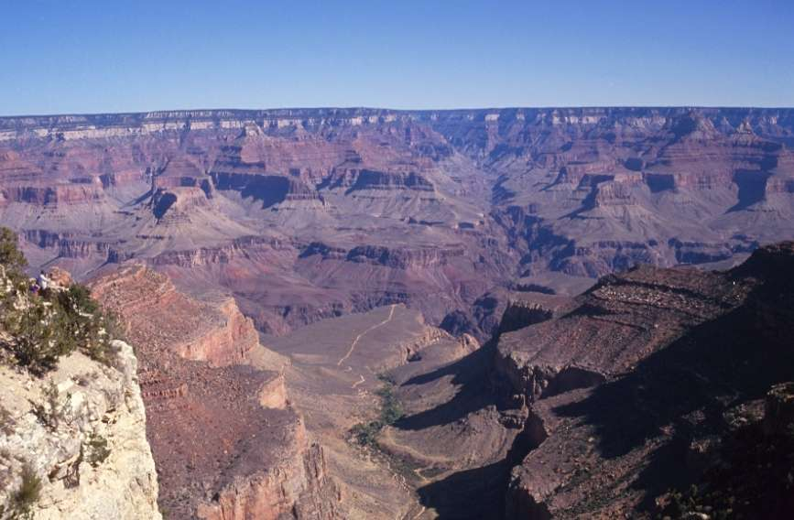
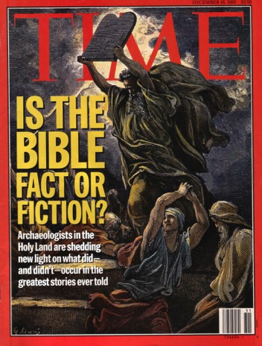
Geological Evidence

Slide 15
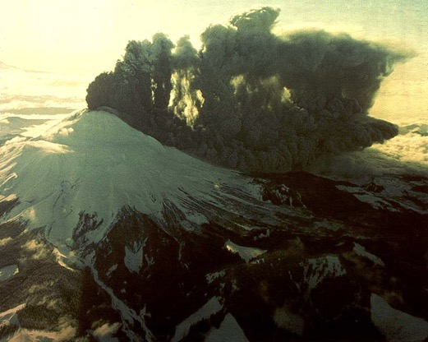
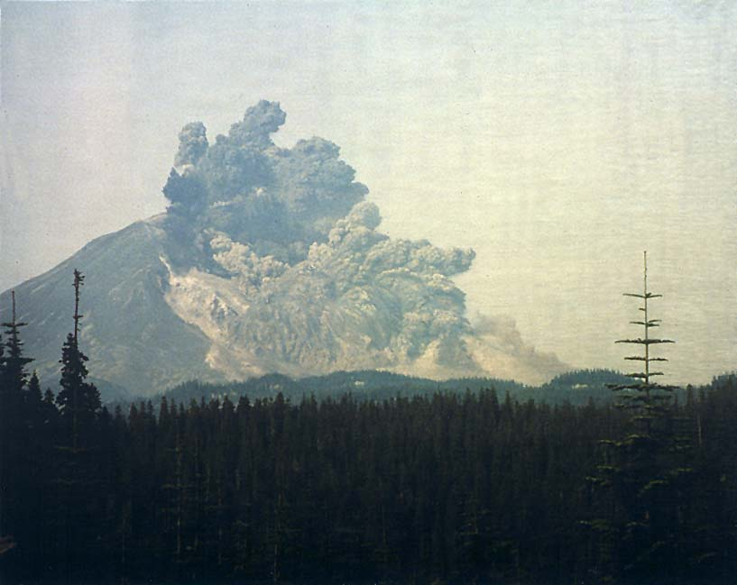
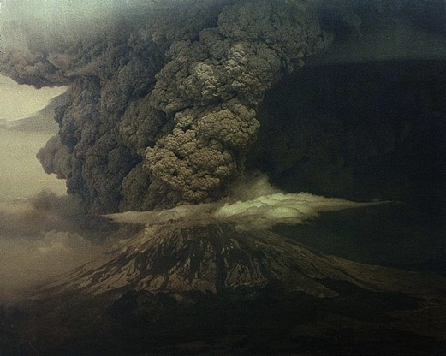
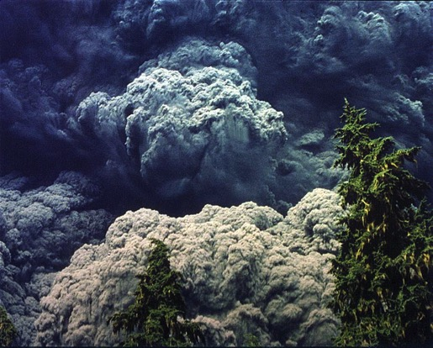
Geologic Observations May 18, 1980

Slide 16
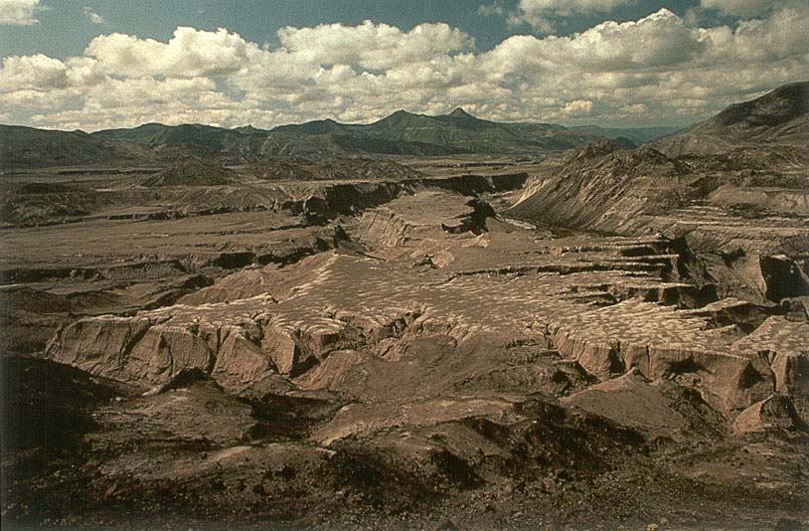
Geologic Processes
The Little Grand Canyon of the Toutle River
Picture by Steve Austin, Ph.D. Geology

Slide 17
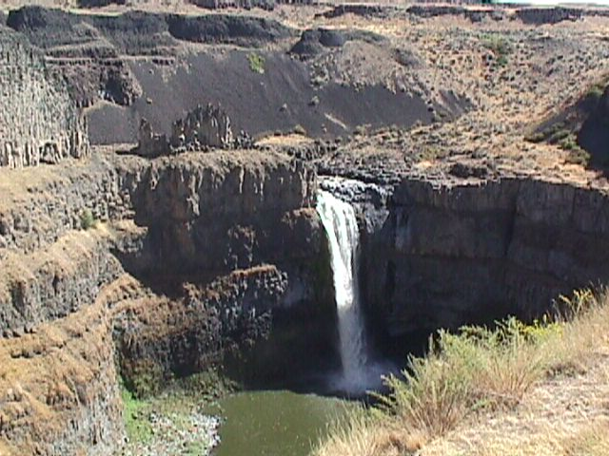
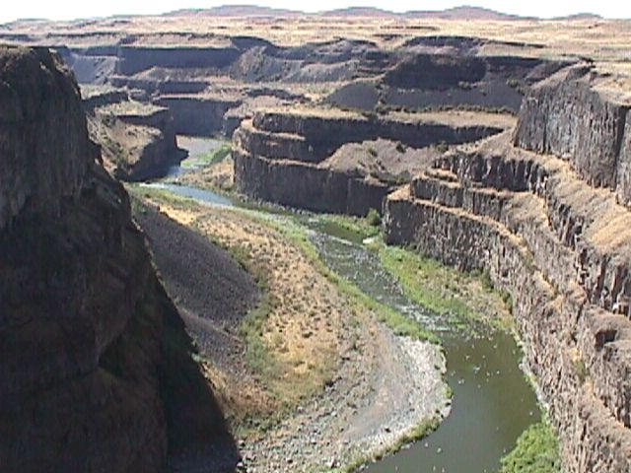
Geologic Processes
Palouse Falls Gorge, WA

Slide 18
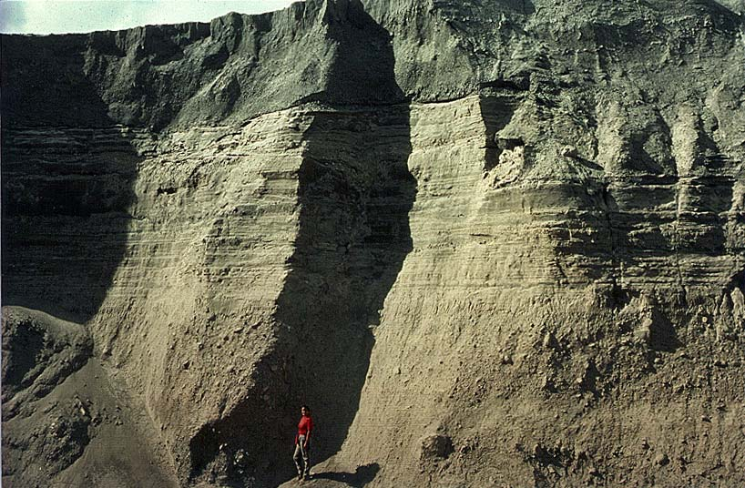
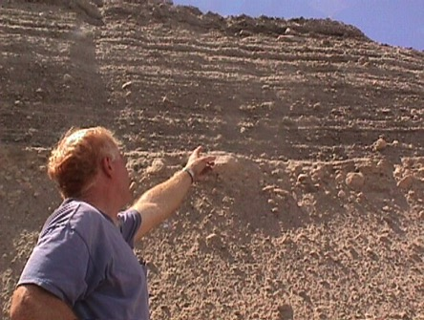
Geologic Processes
Rapidly formed strata on the North Fork of the Toutle River

Slide 19
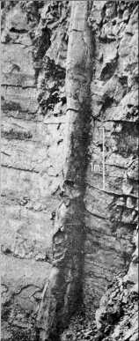
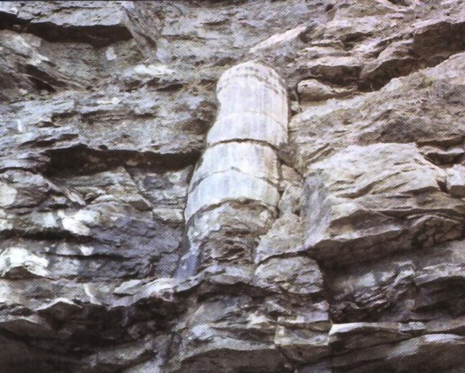
Polystrate Fossils
Picture from the Geology Book by John Morris, Ph.D. Geology

Slide 20
Genesis Flood
Henry Clarence Thiessen, Ph.D., Lectures in Systematic Theology, 1979, p. 117.
“Further, the Bible teaches a universal flood…”

Slide 21
Genesis Flood
Gleason Archer (Ph.D., professor of Old Testament and Semitic languages ), Encyclopedia of Bible Difficulties, 1982, p. 82.
“The biblical record in Genesis 7-8 describes no local inundation confined to the Mesopotamian Valley (as some scholars have suggested) but a water level that surpassed the summits of the highest mountains.”

Slide 22
Science and the Flood
Eugene Merrill, An Historical Survey of the Old Testament, 1998, p. 50.
“If true scientific principle demands an observer and recorder of phenomena, only the Genesis account can be considered scientific, for only it dares to claim that there was an Observer present – the Triune God.”

Slide 23
The Genesis Flood
Keith Wanser, Creation ex nihilo, 1999, p. 39. (Dr. Wanser works with theoretical condensed matter physics and basic theories of matter)
“I am convinced there is far more evidence for a recent, six-day creation and a global Flood than there is for an old earth and evolution.”
The Flood was Worldwide!

Slide 24
The Creation Days
5
Evolution demands long ages
Bible: literal days
Meaning of 'Yom'
Yom with a number
Evening and morning
Genesis 1:14
Exodus 20:11
Words used to indicate time
Narrative versus poetry (VSO or SVO)
In the beginning created God the heavens… = VSO
Genealogies (Gen 5, 1Chron 1, Luke 3)

Slide 25
Genealogical Timeline
Years after creation
Creation
500
1000
1500
2000
2500
930
Adam
874
1651
Lamech
1056
2006
Noah
1879
2084
Terah
2009
2184
Year born after creation
Year died after creation
Abraham
Flood (1656)

Slide 26
The Creation Days
Professor James Barr, Professor of Hebrew at the University of Oxford.
“Probably so far as I know, there is no professor of Hebrew or Old Testament at any world-class university who dares not believe that the writer(s) of Gen. 1-11 intended to convey to their readers the ideas that creation took place in a series of six days which are the same as the days of 24 hours we now experience…”

Slide 27
The Creation Days
Dr. Robert Cole (Ph.D. Semitic Languages), “A PhD looks at the Genesis Days”
“There is nothing in the Bible to obviate the idea that the days in Genesis were 24 hour type days.”

Slide 28
The Creation Days
Robert L. Reymond, Ph.D., A New Systematic Theology of the Christian Faith, 1998, p. 393.
“In the hundreds of other cases in the Old Testament where yom stands in conjunction with an ordinal number (first, second, third, etc.), e.g. Exodus 12:15; 24:16; Leviticus 12:3, it never means anything other than a normal, literal day.”

Slide 29
The Creation Days
Newman (Ph.D. Astrophysics, Th.M. Westiminster Theological Seminary) and Eckelmann (B.S.E.E., M.Div.), Genesis One and the Origin of the Earth, pp. 61-62.
“The more modest claim, that yom means a twenty-four-hour day when used with ordinal numbers (1st, 2nd, 3rd, etc.), has the advantage that no clear counter-example can be cited with yom meaning a long period of time.”

Slide 30
The Creation Days
Douglas F. Kelly (Professor of Systematic Theology) , Creation and Change, 1997, p. 51.
“To summarize, liberal scholars of both 19th and 20th centuries admit that the text of Genesis is clearly meant to be taken in a literal, historical sense, although they deny its claims to speak accurately to our space/time cosmos.”

Slide 31
The Origin of Life
6
Evolution: chance accident
Bible: consistent message
Gen 2:7 Isa 57:16 1 Cor 8:6
Gen 5:2 Matt 19:4 Eph 3:9
Deut 4:32 Mark 10:6 Col 1:16-17
Neh 9:6 John 1: 1-3 Heb 11:3
Ps 89:47 Acts 4:24 2 Pet 1:3
Isa 45:12 Romans 1:19-20 Rev 4:11

Slide 32
What Did Jesus Say
7
Jesus believed Moses: John 5:46-47
Jesus confirmed Abel: Matt 23:35
Jesus confirmed the Flood: Matt 24:37-39
…from the beginning… Mark 10:6
Jesus is the Creator
John 1:1-3, Col 1:16, Heb 1:1-3, Eph 3:9
Why do we believe the Resurrection?

Slide 33
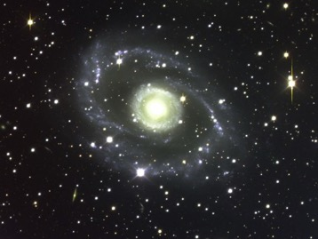
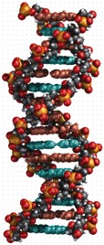
Part 2
Science and
Why It Matters

Slide 34
Evolution, Science, and the Bible
Creation
Evolution
1st Law of Thermodynamics
2nd Law of Thermodynamics
Law of Cause and Effect
Law of Biogenesis
Laws of Science

Slide 35
Christian Doctrine and Science
Danny Faulkner, Ph.D. Astronomy
“Many Christian apologists today accept the big bang and claim that Genesis is in complete agreement with the big bang. However this is a situation driven by science and not by Biblical studies….
Therefore those who accept the big bang and make it part of their Christian apologetics are guilty of interpreting the Bible in terms of current science. This is a dangerous precedent.”

Slide 36
Why It Matters
What We Believe

Slide 37
Why It Matters What We Believe
Genesis 1:31
Exodus 20:11
John 5:46-47
“Very good” creation
Creation in 6-days
Jesus believes in creation
The foundation for Christian doctrines
Who is the last Adam?
Reason for the Gospel
The works of Jesus
Marriage
John 3:16
Sin?
Creation is the foundation

Slide 38
Effects of Evolution
One of the main reasons our youth are leaving the church is that they cannot defend a belief in the Bible
What can be done?
The Bible teaches what can be done
But sanctify the Lord God in your hearts: and be ready always to give an answer to every man that asketh you a reason of the hope that is in you with meekness and fear: (1 Peter 3:15)

Slide 39
Meaning of 1 Peter 3:15
We must understand what we believe
We must understand why we are Christians
We must be able to articulate this belief reasonably and biblically
Notes:
This is an urgent command to preach the Word – the entire written Word even when it is not popular – and right now what is not popular is, In the beginning… But it is the only true history…

Slide 40
The Entire Lecture in Book Format
Is evolution compatible with the Bible?
Does the Bible say how God created?
Is Genesis true history or just a story?
How long were the days of creation?

Slide 41
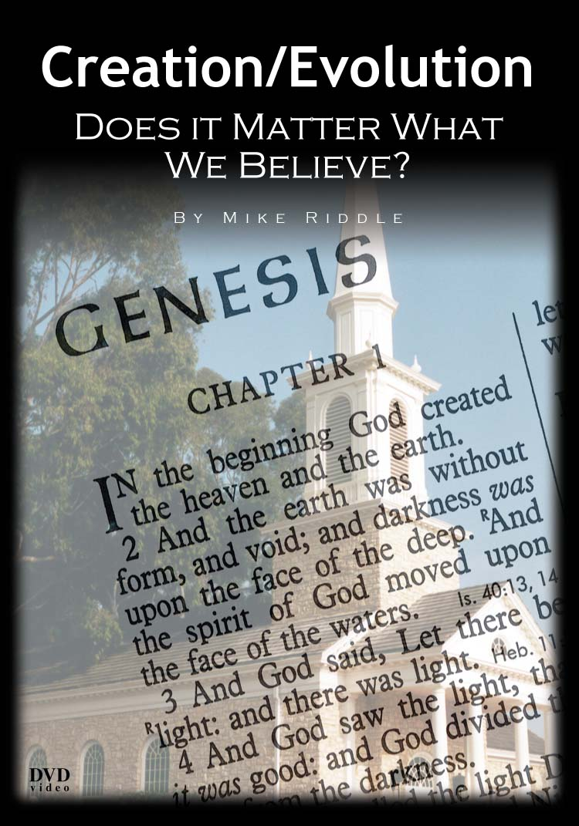
The Lecture on DVD
Plus Free
Lesson plans
Objectives
Detailed outline of the DVD
Exercises
Answer Keys
www.Train2Equip.com

Slide 42
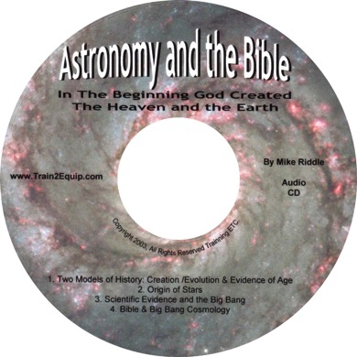
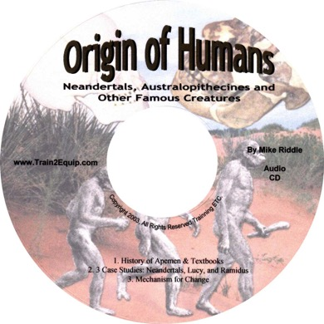
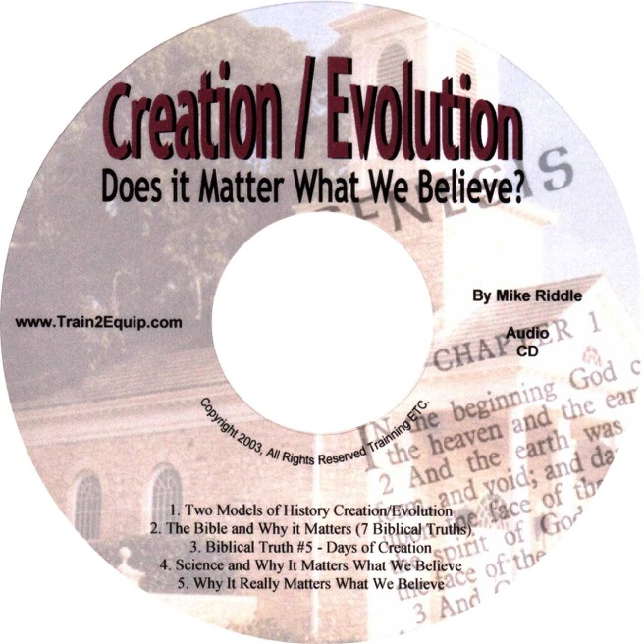
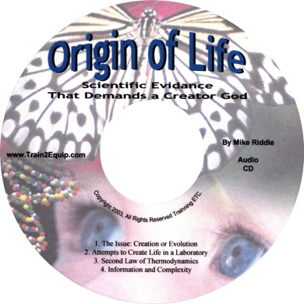
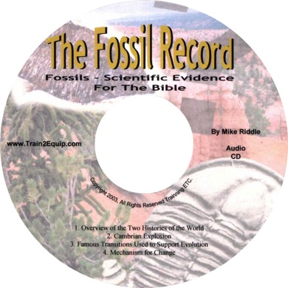
5 New Audio CDs -- $ 8 Each
Complete set of 5 for $35.00

Slide 43
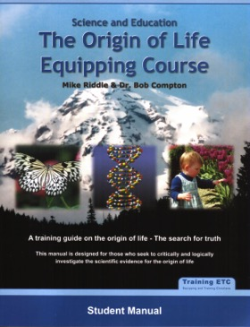
The Origin of Life
Equipping Course
Individual Study Guide

Slide 44
www.Train2Equip.com

Slide 45
Creation/Evolution:
Does It Matter What We Believe?
Mike Riddle
mike@Train2Equip.com
www.icr.org
In the beginning God created…

Slide 46
Black

Slide 47
Creation link at BibleStudyDownloads.org
Get this presentation for free!
Notes:
OT Survey (os)

